Slide 1
International Statistical System
Bishkek, January 23, 2020
Misha V. Belkindas
Managing director
ODW consulting
President Elect, IAOS

Slide 2
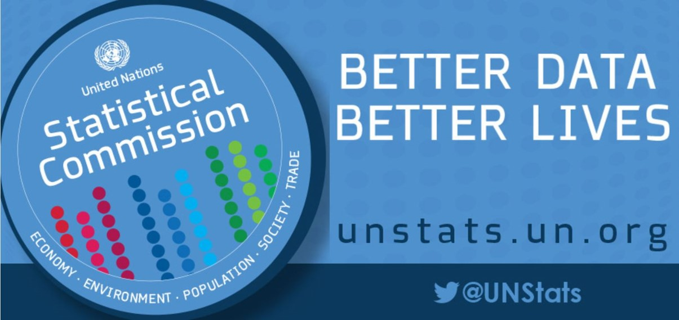
UN Statistical Commission established in 1947 as one of the commissions under Economic and Social Council
MANDATE:
Promote the development of national statistics and the improvement of their comparability
Coordination of the statistical work of specialized agencies
Development of the central statistical services of the secretariat
Advise the organs of the United Nations on general questions relating to the collection, analysis and dissemination of statistical information
Promoting the improvement of statistics and statistical methods generally

Slide 3

MEMBERSHIP IN UN STATISTICAL COMMISSION
24 members in total:
Five members from African States
Four members from Asian States
Four members from Eastern European States
Four members from Latin American and Caribbean States
Seven members from Western European and other States
In addition to the members all other statistical organizations participate as members of the Commission.
International and other organizations participate as observers.

Slide 4

UN STATISTICAL COMMISSION ACTIVITIES & DOCUMENTS
Meets once a year in early March in New York for 4 days
Has a very rich agenda
Develops topics and works by establishing a “friends of the chair” group and “city groups”
After the work of a group is finished the report goes to the Commission for approval
The most important documents are Fundamental Principles of Official Statistics and Handbook of Statistical Organization

Slide 5
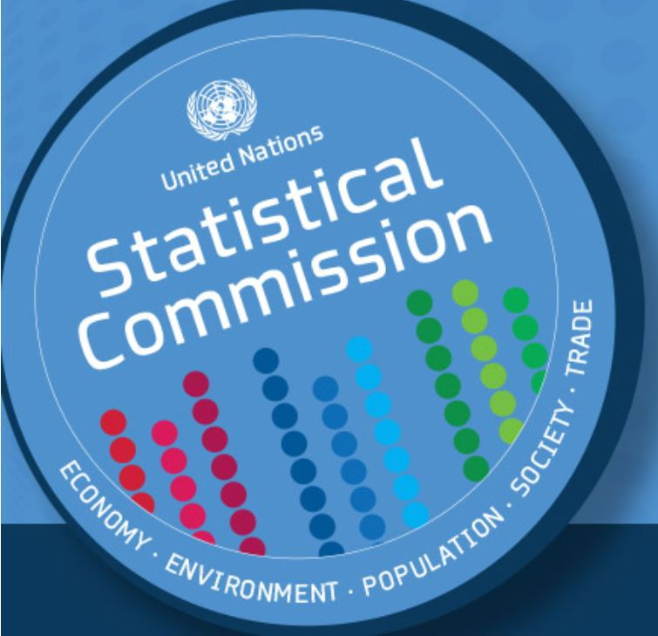
United Nations Statistics Division (UNSD)
The UN Statistical Commission oversees the work of the United Nations Statistics Division (UNSD)
UNSD is based in New York, USA
UNSD convenes interagency groups to prepare important methodological documents – such as 2008 SNA
The interagency groups are comprised of UN, World Bank, IMF, Eurostat and OECD
https://unstats.un.org/home/

Slide 6

Committee for the Coordination of Statistical Activities (CCSA) established in September 2002
The Committee focuses its work on the following six main activities:
Efficient functioning of the statistical system
Common standards and platforms
Development of methodologies
Inter-institutional support
Outreach
Advocacy for statistics
CCSA is comprised of Multilateral Institutions, Regional and Specialized UN Agencies, Regional organizations such as CIS Statistical Committee

Slide 7
UN Regional Commissions
4 regional commissions serve as secretariats for regional Statistical Commissions, while UNECE serves the Conference of European Statisticians
UN Economic Commission for Africa (UNECA) – Addis Ababa - http://www.uneca.org/
UN Economic Commission for Europe (UNECE) – Geneva - http://www.unece.org/
UN Economic Commission for Latin America and the Caribbean (UNECLAC) – Santiago - https://www.cepal.org/en
UN Economic and Social Commission for Asia and the Pacific (UNESCAP) – Bangkok - http://www.unescap.org/
UN Economic and Social Commission for Western Asia (UNESCWA) – Beirut - https://www.unescwa.org/

Slide 8

UN Specialized Agencies
ILO statistics department - https://www.ilo.org/stat/lang--en/index.htm
FAO statistics division - http://www.fao.org/about/who-we-are/departments/statistics-division/en/
WHO statistics directorate - https://www.who.int/healthinfo/statistics/en/
UNESCO Institute for Statistics - http://uis.unesco.org/
ILO statistics department – methodology and rules for labor statistics.
Geneva
FAO statistics division – methodology for agricultural statistics; implementation of Global Program for Agricultural Statistics.
Rome
WHO statistics directorate – methodology for health statistics.
Geneva
UNESCO Institute for Statistics – education statistics.
Montreal
Other – World Tourism Organization, UNDP, UNFPA, UN Women, etc.

Slide 9
Multilateral Institutions
World Bank – debt statistics, household surveys, poverty statistics. Capacity building through loans and grants. Houses the Global Office of the International Comparison Program.
Washington
IMF – national accounts, balance of payments, price statistics, government finance statistics.
Washington

Slide 10
Regional Development Banks and Specialized Banks
African Development Bank – data on African Countries, data web platform, Information highway, statistical capacity building.
Abidjan
Asian Development Bank – leads the ICP regional program, supports countries through loans and grants.
Manila
Islamic Development Bank – supports and finances 57 Islamic countries.
Jeddah
Interamerican Development Bank – supports countries through loans and grants.
Washington

Slide 11
Regional Agencies and Initiatives
Eurostat – provides methodological materials for EU countries based on international recommendations. Provides technical assistance to countries outside the EU.
Based in Luxembourg.
Web-address: https://ec.europa.eu/eurostat
OECD Statistics and Data Directorate – serves as statistical committee for OECD countries, provides methodological recommendations. Runs statistical data base on Official Development Assistance.
Based in Paris.
Web-address: https://www.oecd.org/sdd/

Slide 12
National Statistical Systems
Collect and compile data according to international standards
Make data available to policy makers, civil society and private sector
Provide data to international and regional organizations
Provide data to international databases
Participate in international statistical programs and projects

Slide 13

Paris21 (Partnership in Statistics in the 21st Century) established by the World Bank and Government of United Kingdom in 1999
Established as a forum for discussions between statisticians and policy makers. Since then became a serious player/part of the international statistical system, leading the NSDS process, capacity building, big data, working with data users, etc.
Paris21 secretariat is housed by OECD in Paris.
Web-address: https://paris21.org/

Slide 14

International Statistical Institute (ISI) and its Associations established in 1885 in London is one of the oldest professional organizations in the world
Most of its members come from different areas of statistics including those working in official statistics.
ISI every two years holds a congress hosted by one of its member countries statistical agencies. The congresses are held in odd years. Usually more the 2000 people attend the congress.
ISI has its regional outreach committees who organize regional ISI conferences.
ISI has 7 associations one of them is International Association of Official Statistics (IAOS). It organizes its congresses every two years in even years. In 2020 IAOS congress will be held in Zambia together with ISI regional conference for Africa.
ISI permanent office in based in The Hague.
Web-address: https://isi-web.org/

Slide 15
Worldwide Statistical Programs
Population Census Program – led by UNFPA and supported by UNSD
Global Agricultural Program – developed by the World Bank and led by FAO
Agricultural Census Program – led by FAO

Slide 16
Worldwide Statistical Programs (cont’d)
International Comparison Program -
decided by UNSC
managed by the World Bank
Regional Programs -
run by African Development Bank,
UNECLAC, UNECWA,
Asian Development Bank, CIS STAT and ROSSTAT, OECD and Eurostat
Country programs in more than 180 countries collect price data at the same time for the same basket of goods

Slide 17

Interlinkages in the World Statistical System
National statistical systems:
  Organize the legal environment allowing a statistical system to function
  Arrive at an institutional structure enabling to collect and compile official statistics according to international standards as to be compatible and comparable with other parts of international statistical system
  Provide data to the public, governments and private sector
  Provide data to regional and international organizations allowing to develop regional and international policies

Slide 18
Interlinkages in the World Statistical System (cont’d)
Regional level of international statistical system:
Provides international standards and methodologies adopted to the needs of the regions, if needed
Develops and maintains regional databases
Provides regional data at intra-country comparable level
Provides data to policy makers for regional policy and regional programs

Slide 19
Interlinkages in the World Statistical System (cont’d)
International level of international statistical system:
  Provides recommendations on legal and institutional structures of national statistical systems
  Provides standards and methodologies to be applied to data and indicators worldwide at country, regional and international levels
  Approves worldwide statistical programs
  Conducts UN Statistical Commission meetings and UN World Data Forums
  Conducts other meetings at international, regional and country levels

Slide 20
Interlinkages in the World Statistical System (cont’d)
The World Statistical Systems are as good or weak as is the weakest country link

Slide 21

Sustainable Development Goals – new requirements to the International Statistical System
In 2015 the United Nations adopted the Sustainable Development Goals which have 17 goals over 160 targets. The statistical community came up with indicators to measure achievement of the SDGs. There are more than 240 indicators some of them are ready to measure, where some still do not have the methodology how to compile them. The SDGs put big pressure on the international statistical system at country and international level.
UNSD in 2015 created High-level Group for Partnership, Coordination and Capacity-Building for statistics for the 2030 Agenda for Sustainable Development (HLG-PCCB), composed of Member States and including regional and international agencies. They are in lead on the SDG indicators.

Slide 22
Sustainable Development Goals – new requirements to the International Statistical System (cont’d)
As the SDG’s were adopted at the highest political level the statistical systems of all the countries are obliged to measure SDG’s
The international statistical system developed and approved the list of indicators
Custodian agencies for each indicator located at international agencies are developing standards and methodologies for compilation of indicators
Regional agencies work on regionalization of indicators, if needed
Country statistical systems collect and compile SDG indicators

Slide 23

Global Partnership for Sustainable Development Data
The international community responded by bringing in the UN system, international organizations, civil society and private sector by organizing Global Partnership for Sustainable Development Data (GPSDD) They have more than 100 institutional members:
Governments to improve policymaking and service delivery, including aligning budgets with needs.
Citizens and civil society groups to make better decisions and hold leaders accountable for their actions.
Companies to build capacity and drive entrepreneurship and innovation.
Statistical systems to develop indicators and deliver data for measuring development.
Web-address: http://www.data4sdgs.org/

Slide 24

World Data Forums
It was agreed that UN and GPSDD will organize World Data Forums every two years to discuss the importance of good data and to agree on actions needed moving forward.
The first forum took place in Cape Town, South Africa in early 2017 and was attended by statisticians, policy makers, civil society and private sector. This wide audience have the ability and capacity to discuss the data issues much broader than the statistical community. The forum ended with adoption of Cape Town Global Action Plan for Sustainable Development Data which was prepared by the High-level Group for Partnership, Coordination and Capacity-Building for Statistics for the 2030 Agenda for Sustainable Development.
The second forum took place in Dubai in late 2018 and the next will take place in Bern, Switzerland in October 2020.
The world statistical systems meets at the WDF with a wide range of partners to discuss the future of the World Statistical System.
Web-address: https://unstats.un.org/unsd/undataforum/index.html

Slide 25
Thank you!
mishabelkindas@opendatawatch.com

